Slide 1
Concept Generation Ideas NASA Solar Panel
Deploying Mechanism
Pressure Induced
Roll-out & retract method
Mimosa leaf expansion
Surface Tension Expansion
Hydration of hydrophobic fibers
Tri-block copolymer expansion
Electric shape memory
Electric change can cause panel to deploy & retract
Nonwoven mats were not ideal for surface tension expansion
Linearly/radially aligned fibers are needed
UTPA

Slide 2
Methodology
Brainstorming
  Develop concepts for force generation
  PV material
  Size & weight of mechanism
Background Research
  Patent search
  Research articles (solar cell & deployment mechanisms)
  Competitive market
Experimentation
  Trial & error testing
UTPA

Slide 3
Functional Decomposition
Membrane
Structure
Deployment Mechanism
Flexible PV Material
Triggering Source
UTPA

Slide 4
Sub-Function l – Deployment Mechanism
Design Constraints:
  Weight
  Cost
  Time to Deploy
Concept Variants:
  Actuators/Linkages
  Pressure Induced
  Shape Memory Material
 | Weight | Cost | Time to Deploy | Row Sum | Nom. Score
Weight | x | 4 | 3 | 7 | 0.389
Cost | 2 | X | 3 | 5 | 0.278
Time to Deploy | 3 | 3 | x | 6 | 0.333
Col. Sum | 5 | 7 | 6 | 18 | 1
UTPA

Slide 5
Sub-Function l – Deployment Mechanism
Weight | Actuators/Linkages | Pressure Induced | Shape Memory Material | Row sum | Norm. Score
Actuators/Linkages | X | 2 | 1 | 3 | 0.167
Pressure Induced | 4 | X | 4 | 8 | 0.444
Shape Memory Material | 5 | 2 | X | 7 | 0.389
Col. Sum | 9 | 4 | 5 | 18 | 1
Cost | Actuators/Linkages | Pressure Induced | Shape Memory Material | Row sum | Norm. Score
Actuators/Linkages | X | 1 | 1 | 2 | 0.111
Pressure Induced | 5 | X | 5 | 10 | 0.556
Shape Memory Material | 5 | 1 | X | 6 | 0.333
Col. Sum | 10 | 2 | 6 | 18 | 1
Time to Deploy | Actuators/Linkages | Pressure Induced | Shape Memory Material | Row sum | Norm. Score
Actuators/Linkages | X | 2 | 1 | 3 | 0.167
Pressure Induced | 4 | X | 5 | 9 | 0.500
Shape Memory Material | 5 | 1 | X | 6 | 0.333
Col. Sum | 9 | 3 | 6 | 18 | 1
UTPA

Slide 6
Sub-Function l – Selection
Deployment Mechanism Decision
 | Weight | Cost | Time to Deploy | Score
Actuators/Linkages | 0.0567 | 0.0367 | 0.0567 | 0.15
Pressure Induced | 0.1467 | 0.1867 | 0.1667 | 0.50
Shape Memory | 0.13 | 0.11 | 0.11 | 0.35
Decision |  |  |  | Pressure Induced Wins
UTPA

Slide 7
Sub-Function lI – Membrane Structure
Design Constraints:
  Membrane Stiffness - Strength
  Membrane Flexibility
  Cost
Concept Variants:
  LDPE
  Nylon-6
  PET
  Thin Aluminum Foil
 | Stiffness Strength | Membrane Flexibility | Cost | Row Sum | Normalized Score
Stiffness Strength | x | 2 | 3 | 5 | 0.278
Membrane Flexibility | 4 | x | 3 | 7 | 0.389
Cost | 3 | 3 | x | 6 | 0.333
Colum Sum | 7 | 5 | 6 | 18 | 1.00
UTPA

Slide 8
Sub-Function lI – Membrane Structure
Membrane Stiffness Strength | LDPE | Nylon-6 | PET | Thin Aluminum foil | Row Sum | Normalized Score
LDPE | x | 2 | 1 | 1 | 4 | 0.111
Nylon-6 | 3 | x | 3 | 2 | 8 | 0.222
PET | 5 | 4 | X | 3 | 12 | 0.333
Thin Aluminum foil | 4 | 5 | 3 | X | 12 | 0.333
Colum Sum | 12 | 11 | 7 | 6 | 36 | 1
Membrane Flexibility | LDPE | Nylon-6 | PET | Thin Aluminum foil | Row Sum | Normalized Score
LDPE | x | 4 | 3 | 5 | 12 | 0.333
Nylon-6 | 2 | X | 4 | 5 | 11 | 0.306
PET | 2 | 2 | X | 5 | 9 | 0.250
Thin Aluminum foil | 2 | 1 | 1 | x | 4 | 0.111
Colum Sum | 3 | 7 | 7 | 15 | 36 | 1
Cost | LDPE | Nylon-6 | PET | Thin Aluminum foil | Row Sum | Normalized Score
LDPE | x | 2 | 2 | 2 | 6 | 0.167
Nylon-6 | 1 | x | 2 | 4 | 7 | 0.194
PET | 4 | 5 | x | 4 | 13 | 0.361
Thin Aluminum foil | 5 | 3 | 2 | x | 10 | 0.278
Colum Sum | 10 | 10 | 6 | 10 | 36 | 1
UTPA

Slide 9
Sub-Function lI – Selection
Membrane Decision
 | Stiffness | Flexibility | Cost | Score
PET | 0.111 | 0.083 | 0.120 | 0.314
Nylon-6 | 0.074 | 0.102 | 0.065 | 0.241
LDPE | 0.037 | 0.111 | 0.055 | 0.203
Thin Al Foil | 0.111 | 0.037 | 0.093 | 0.241
Decision |  |  |  | PET Wins
UTPA

Slide 10
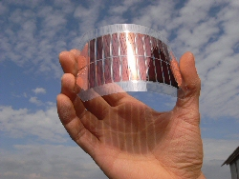
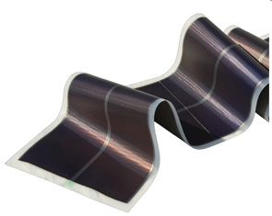
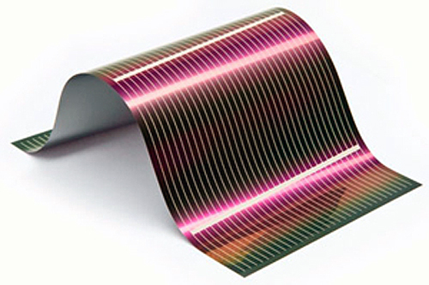
Sub-Function lll – PV Material
1.
Design Constraints:
  Flexibility
  Cost
  Efficiency
2.
Concept Variants:
  Organic Polymer
  Amorphous Silicon
  CIGS (Copper Indium Gallium Selenide)
3.
 | Flexibility |  | Efficiency | Row Sum | Nom. Score
Flexibility | x | 4 | 4 | 8 | 0.444
Cost | 2 | x | 3 | 5 | 0.278
Efficiency | 2 | 3 | x | 5 | 0.278
Col. Sum | 4 | 7 | 7 | 18 | 1
UTPA

Slide 11
Sub-Function lll – PV Material
Concept Variant Rankings with Respect to Power Efficiency
Power Efficiency | Organic Polymer | Si: crystalline, amorphous | CIGS, CZTS | Row sum | Norm. Score
Organic Polymer | x | 2 | 1 | 3 | 0.167
Si: crystalline, amorphous | 4 | x | 3 | 7 | 0.389
CIGS, CZTS | 5 | 3 | x | 8 | 0.444
Col. Sum | 9 | 5 | 4 | 18 | 1
Concept Variant Rankings with Respect to Cost
Cost | Organic Polymer | Si: crystalline, amorphous | CIGS, CZTS | Row sum | Norm. Score
Organic Polymer | x | 5 | 5 | 10 | 0.556
Si: crystalline, amorphous | 1 | x | 3 | 4 | 0.222
CIGS, CZTS | 1 | 3 | x | 4 | 0.222
Col. Sum | 2 | 8 | 8 | 18 | 1
Concept Variant Rankings with Respect to Flexibility
Flexibility | Organic Polymer | Si: crystalline, amorphous | CIGS, CZTS | Row sum | Norm. Score
Organic Polymer | x | 5 | 5 | 10 | 0.556
Si: crystalline, amorphous | 1 | x | 4 | 5 | 0.278
CIGS, CZTS | 1 | 2 | x | 3 | 0.167
Col. Sum | 2 | 7 | 9 | 18 | 1
UTPA

Slide 12
Sub-Function lII – Selection
PV Material Decision
 | Efficiency | Cost | Flexibility | Score
Organic Polymer | 0.0556 | 0.1852 | 0.1852 | 0.4260
Si: crystalline, amorphous | 0.1296 | 0.0741 | 0.0926 | 0.2963
CIGS, CZTS | 0.1481 | 0.0741 | 0.0556 | 0.2778
Decision |  |  |  | Organic Polymer Wins
UTPA

Slide 13
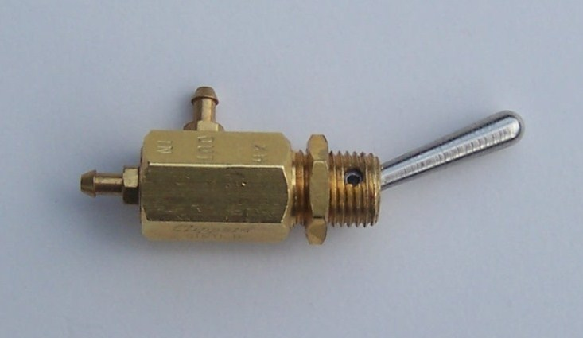
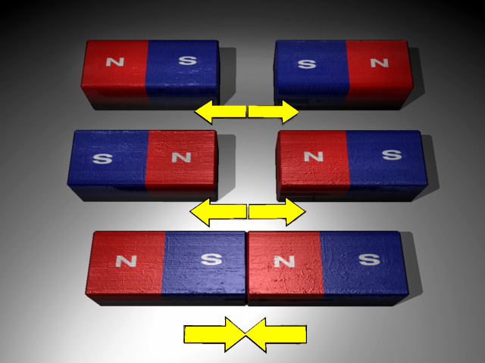
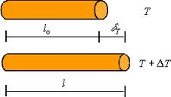
Sub-Function lV - Triggering Source
1.
2.
Design Constraints:
  Weight
  Cost
  Power
Design Variants:
  Pump / Solenoid Switch
  Magnets
  Thermal Expansion
3.
Triggering Source | Weight | Cost | Power | Sum of Row | Weight Score
Weight | X | 3 | 2 | 5 | 0.278
Cost | 3 | X | 2 | 5 | 0.278
Power | 4 | 4 | X | 8 | 0.444
 | 7 | 7 | 4 | 18 | 1
UTPA
Notes:
Pump – solenoid → lever/switch
Magnet – polarity → electric current
Thermal – heat transfer → electric current

Slide 14
Sub-Function lV - Triggering Source
Weight | Air | Magnetic | Thermal | Sum of Row | Weight Score
Air | X | 4 | 3 | 7 | 0.389
Magnetic | 2 | X | 3 | 5 | 0.278
Thermal | 3 | 3 | X | 6 | 0.333
 |  |  |  | 18 | 1
Cost | Air | Magnetic | Thermal | Sum of Row | Weight Score
Air | X | 3 | 5 | 8 | 0.444
Magnetic | 3 | X | 3 | 6 | 0.333
Thermal | 1 | 3 | X | 4 | 0.222
 |  |  |  | 18 | 1
Power | Air | Magnetic | Thermal | Sum of Row | Weight Score
Air | X | 4 | 4 | 8 | 0.444
Magnetic | 2 | X | 3 | 5 | 0.278
Thermal | 2 | 3 | X | 5 | 0.278
 |  |  |  | 18 | 1
UTPA

Slide 15
Sub-Function lV – Selection
Decision | Weight | Cost | Power | Score
Air | 0.130 | 0.148 | 0.148 | 0.426
Magnetic | 0.093 | 0.111 | 0.093 | 0.297
Thermal | 0.111 | 0.074 | 0.093 | 0.278
UTPA

Slide 16
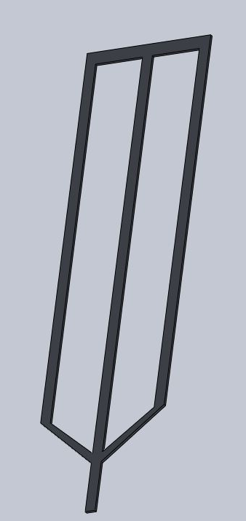
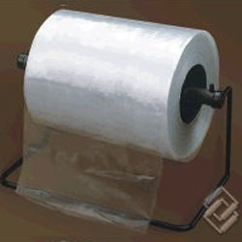
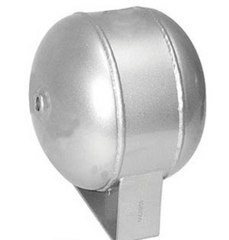
Final Design
Membrane
Structure
Deployment Mechanism
Flexible PV Material
Triggering Source
UTPA

Slide 17
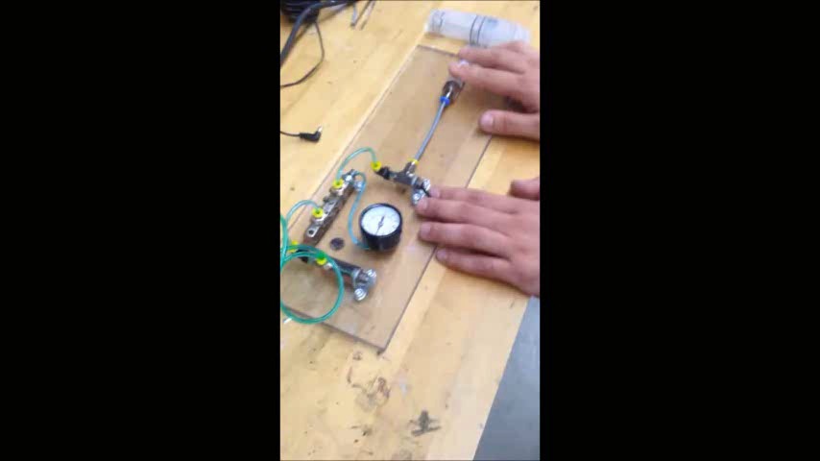
Concept Design
UTPA

Slide 18
References
¹ D.Parry, NRL Press Release, (2012)
² M. Schubert and J. Werner, Materials Today, 9 (2006)
³ C.Clark, Small Satellite Conference, 2 (2003)
⁴ Z. Yang et al., Angewandte Chemie, 52 (2013)
⁵ H. Spanggaard et al., Sol. Enrg. Mat. & Sol. Cell, 83(2004)
⁶ Anthony Watts, Whats Up With That, (2010)
⁷ "US Patent Full-Text Database Number Search." US Patent Full-Text Database
Number Search. N.p., n.d. Web. 21 Nov. 2013.
UTPA

